Slide 1
Module 5
Relational Database Management Systems

Slide 2
MySQL Architecture
MySQL follows the client-server architecture, which divides the system into two main components: Client and Server.

Slide 3
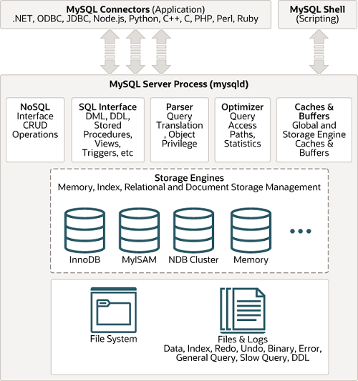
MySQL Architecture

Slide 4
Client
The client is the application that interacts with the MySQL database server.
The client can be a standalone application, a web application, or any program that needs a database.
The client sends SQL queries to the MySQL server for processing.

Slide 5
Server
The server is the MySQL database management system responsible for storing, managing, and processing data.
The server receives SQL queries, processes them, and returns the result sets.
The server manages multiple clients’ data storage, security, and concurrent access.

Slide 6
Client
The client communicates with the server over the network using MySQL protocol. The client-server architecture allows for the separation of concerns and enables multiple clients to interact with MySQL concurrently.
In the client-server architecture, the applications use MySQL connectors to connect to the MySQL database server. The applications can be developed using various programming languages such as Java, PHP, Python, Perl, and JavaScript (Node.js)

Slide 7
Cont..
MySQL also comes with some of the MySQL client tool that allows you to interact with the MySQL database server:
MySQL Workbench (GUI-based).
MySQL client (terminal-based).
MySQL shell.

Slide 8
MySQL Database Server
MySQL database server includes several processes
NoSQL manages schema-less data storage, often used for unstructured or semi-structured data.
SQL Interface defines a standardized interface enabling applications to interact with relational databases using SQL queries.
Query Parser is responsible for analyzing SQL queries to understand their structure and syntax, breaking them down into components for further processing.

Slide 9
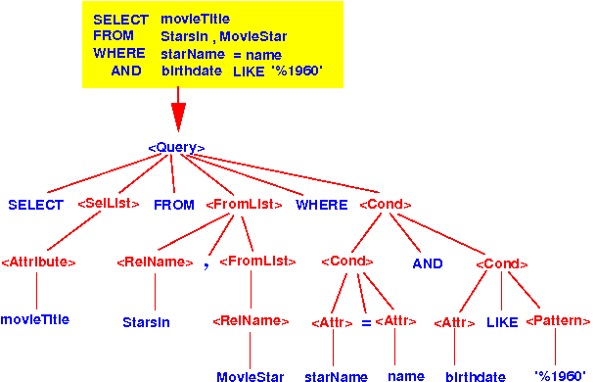
Example- Query Parser

Slide 10
Cont..
Query Optimizer evaluates various execution plans for a given query and selects the most efficient one to enhance the performance of database operations.
Caches & Buffers store frequently accessed data or query results in memory, reducing the need to repeatedly access the underlying storage and improving overall system performance.

Slide 11
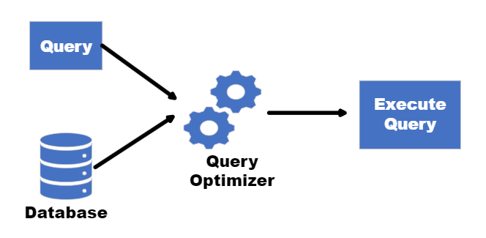
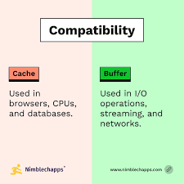
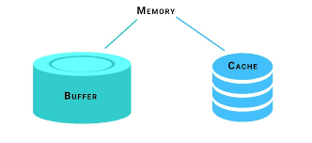

Slide 12
Storage Engines
In MySQL, a storage engine is a component that is in charge of storage, retrieval, and management of data in the database.
MySQL uses a pluggable storage engine architecture that allows you to select different storage engines such as InnoDB, MyISAM, and others.
The pluggable storage engine architecture provides flexibility to meet specific performance and scalability requirements while maintaining a consistent SQL interface and overall database functionality.

Slide 13
File systems
The file system organizes and stores various file types, including data and index files. MySQL uses log files to maintain transactional consistency and support recovery mechanisms. Typically log files are binary and redo logs.

Slide 14
Dedicated Server
In DBMS, a dedicated server is a powerful, physical machine entirely reserved for one client, providing exclusive access to all its resources (CPU, RAM, storage) for running databases, ensuring maximum performance, security, and control, unlike shared servers where resources are split. It's ideal for critical, resource-intensive applications needing high availability and isolation, with the client managing configurations or opting for managed services for maintenance.

Slide 15
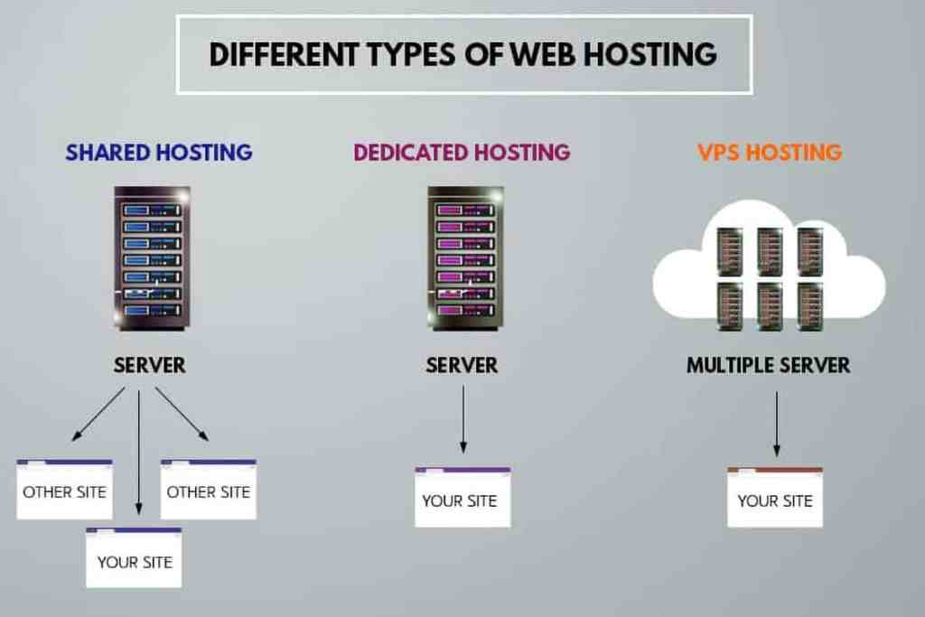

Slide 16


Slide 17
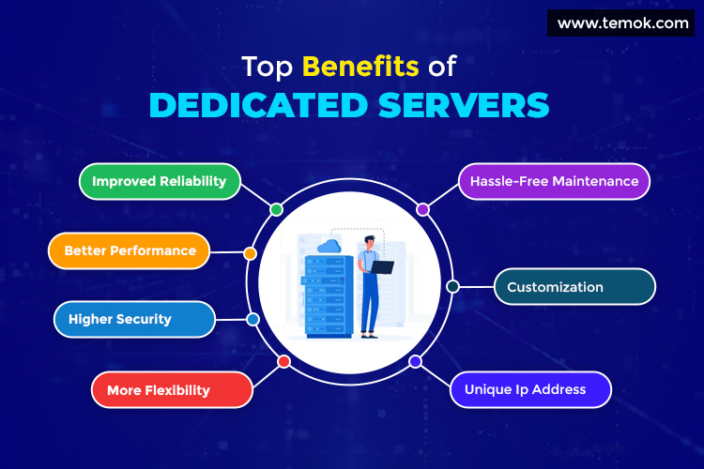

Slide 18
Multithreaded Server
A multi-threaded server handles multiple client requests concurrently by creating a separate thread of execution for each request, allowing it to serve many users or tasks at once without waiting, unlike single-threaded servers that process requests one by one. This improves responsiveness and efficiency, making it ideal for web servers (HTTP), databases, and real-time applications like chat or streaming, where quick parallel processing is crucial.

Slide 19
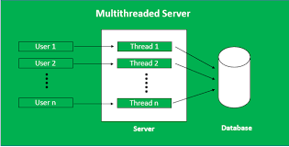

Slide 20
Distributed Database
A distributed database stores data across multiple interconnected computers (nodes) in different locations, appearing as a single logical database to users, which enhances scalability, reliability (fault tolerance), and performance by reducing load on any single machine and allowing local data access. Instead of one central system, data is spread out and managed by a Distributed Database Management System (DDBMS) across servers, enabling horizontal scaling by adding more nodes.

Slide 21
